Slide 1
Research on Image Processing (Deep Corn)

Slide 2
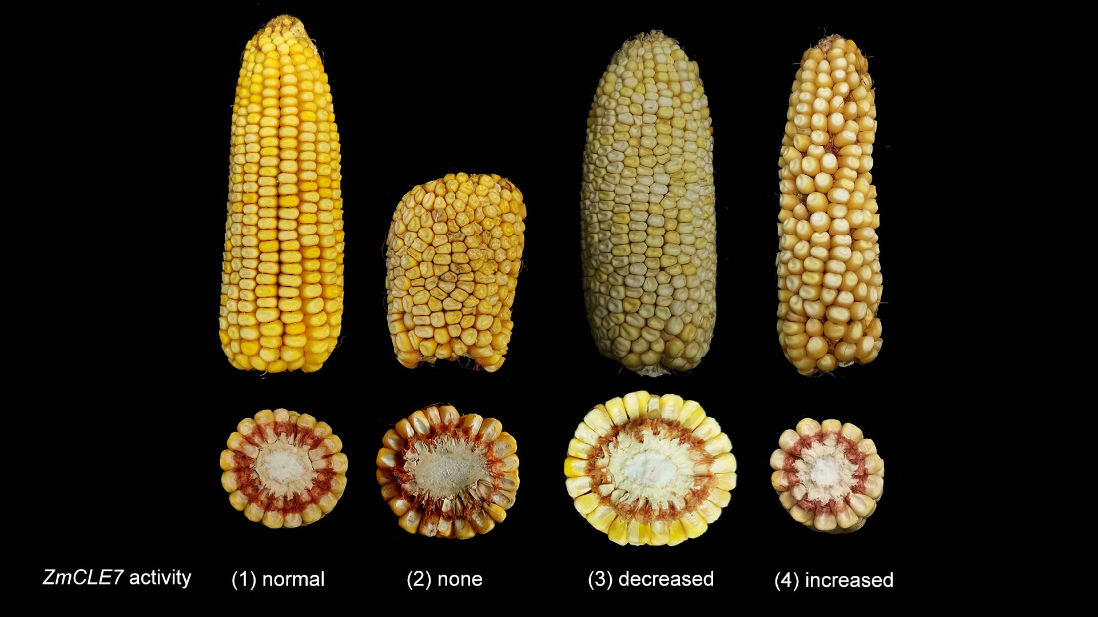
INTRODUCTION
The corn image processing was done on various parameters like the depth of the kernels and the size of the kernel, the diseases of the corn leaves etc.
Basically we go through with manually to check the corn which is infected or not as well as counting of the kernels for each corn cob.
So, these process will take more time consume and we need to over come these problem by implementing the Deep Learning and AI techniques.

Slide 3



Technology Prerequisites
1. Deep Learning with Machine Learning algorithms
2. MATLAB
3. Convolutional Neural Network
4. Recurrent Neural Network (RNN)
5. Pixofarm

Slide 4
Technologies
Deep learning is built on a combination of machine learning algorithms that use multiple nonlinear transformations to model high-level abstractions in data.
Recurrent neural network (RNN) and convolutional neural network (CNN) are two standard deep learning networks used in agriculture.
Pixofarm is a solution based on image processing, where the source of data is a number of pictures of fruits taken directly in the orchard throughout the entire season.
IoT Devices like scanners, Mobile Lens etc.

Slide 5
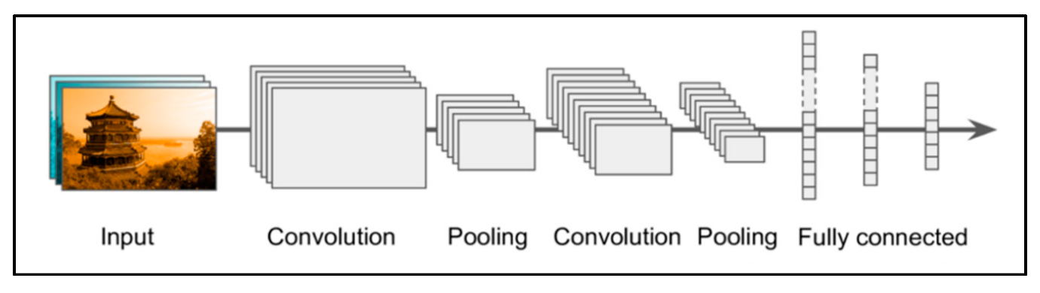
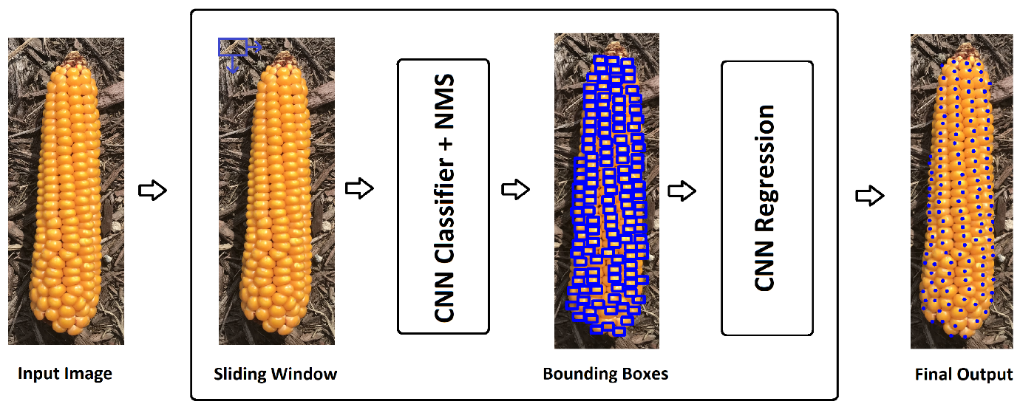
Technology
CNNs have been used for image classification, object detection, fragmentation of images, voice recognition, text and video processing, and medical image analysis, among other functions.
Still at present, the collection of images are done after the corn is plucked from the tree.
Image Process

Slide 6
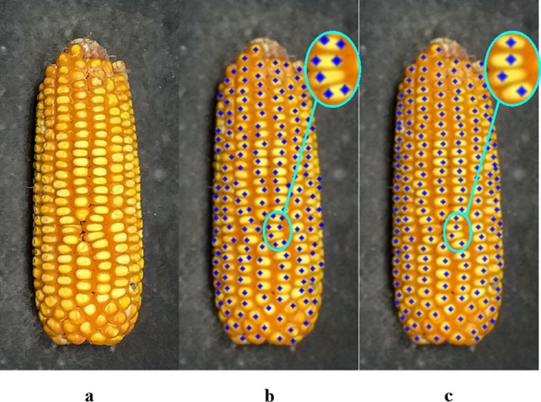
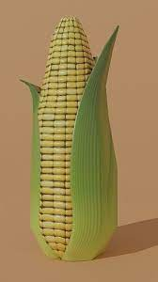
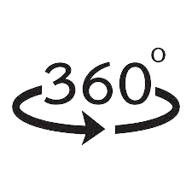
Image Detection
2D Image
3D Image

Slide 7
2D Vs 3D Image
2D Image
3D Image
In previous research there were went through taking counting of the kernel in 180 degrees and remaining 180 degrees will be calculated by a value of 2.7
The counting is difficult and to identify disease of the plant is also most important.
In 3D, we will take the help of IoT devices and take the snap of 360 degree of the corn which is not plucked from the tree.
By testing the silk hair, leafs of the corn plant all are done by IoT device lens.
Length, width of the corn are measured.

Slide 8
What is our Aim
Kernel Quality and
No. of Kernels per each
corn
Our Aim is calculate the length, width and kernels for each corn which is not plucked from the plant. By using the IoT devices or mobile lens.
We need to get the statistics of the corn
Length of the corn

Slide 9
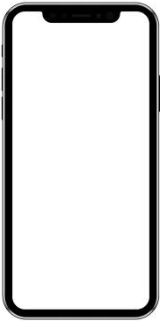
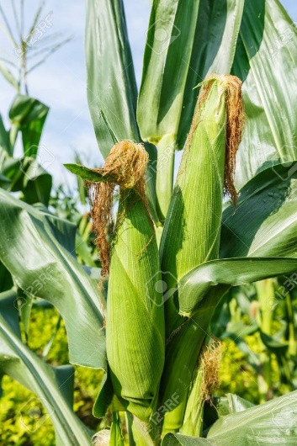

Image Process on Deep Corn
Scan the Image
Description | Result
Silk Hair | Good / Bad
Corn Leaf Disease | Ok / Infected
Description | Result | Remarks
Corn Ear Length | 21.4 Cm | All Good
Corn Ear Width | Xx Cm
Kernels per row | 16 | Ok
Kernel Quality | Some are good | Some are infected
No. of Kernels | 700 | Some are damaged
Get the Result

Slide 10
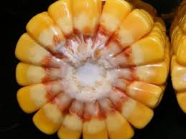
Research for Deep Corn Images
Previous reports said that they are breaking the corn and finding the kernels.
By using python and image processing techniques these are the previous researches.

Slide 11
Summary
Coming to Overall summary on the deep corn by the end of 2021 there was so many researches are done by finding the disease of the leaves, counting of kernels, finding colour of the kernel.
But there is no research or any testing stage implemented on the finding of the ear length, ear height, and kernel counting which is not picked from the corn tree.
Still there was testing going on the counting of kernel, diseases etc.

Slide 12
Any Queries

